Slide 1



Vancouver welcomes you!
MILAN GRITTA, MOHAMMAD TAHER PILEHVAR, NUT LIMSOPATHAM, NIGEL COLLIER
Minimalist metonymy resolution

Slide 2
THE ROAD MAP
the problem + brief HISTORY
PREWIN
FEATURE SELECTION
MODEL
MINIMALIST NN
RELOCAR
NEW DATASET
RESULTS + SUMMARY

Slide 3
THE ROAD MAP
the problem + brief HISTORY
PREWIN
FEATURE SELECTION
MODEL
MINIMALIST NN
RELOCAR
NEW DATASET
RESULTS + SUMMARY

Slide 4
what is a (metonymic) location?
GEOGRAPHICAL PARSING PHD RESEARCH
Moscow to discuss ebola risks in west Africa..
aluminium and gas trading picked up in Moscow.
London voted to stay in the European union..
London constituency voted to remain in the eu.
metonymy ~20% of all locations (BNC, WIkipedia)

Slide 5
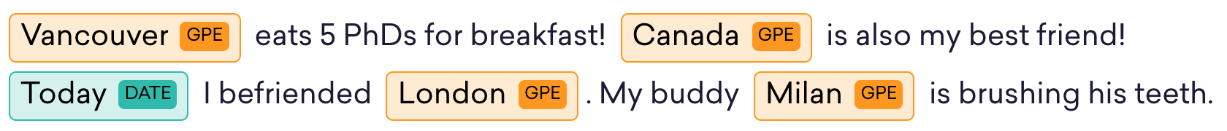
Ner & metonymy - greatest problem in nlp? or nobody cares!?

Slide 6
very brief history of metonymy resolution
Nissim et al. (2002, 03, 05) SEMEVAL (2007) Shared Task
Brun et al. (2007) 85.1%
Farkas et al. (2007) 85.2%
Nastase et al. (2009, 2012) 86.1%
Nastase et al. (2013) 86.2%
Zhang et al. (2015) 86.5**
Gram. role (obj, subj)
Determiner of PMW
Head modifier (dependency)
1
PMW (singular, plural)
No of words in PMW
No of gram. roles of PMW
Manual annotations: syntactical/grammatical
MASCARA additional data
Collocations list
EXPENSIVE, TIME CONSUMING AND REQUIRES EXPERtISE
VerbNet
Co-occurrence lists
Parsing BNC
FrameNet
2
Multiple Parsers
POS Tags
Parsing Wikipedia
Global Context
Proprietary Parser
Levin’s Verb Classes
Selectional Preferences
Trigger Word Lists
task dependent and/or
Heavy Feature engineering
Custom Databases
Handmade Features
3
Naïve Bayes
ME Classifier
Decision List
Unsupervised Context Similarity
SVM
** not peer reviewed, only in preprint

Slide 7
THE ROAD MAP
the problem + brief HISTORY
PREWIN
FEATURE SELECTION
MODEL
MINIMALIST NN
RELOCAR
NEW DATASET
RESULTS + SUMMARY

Slide 8
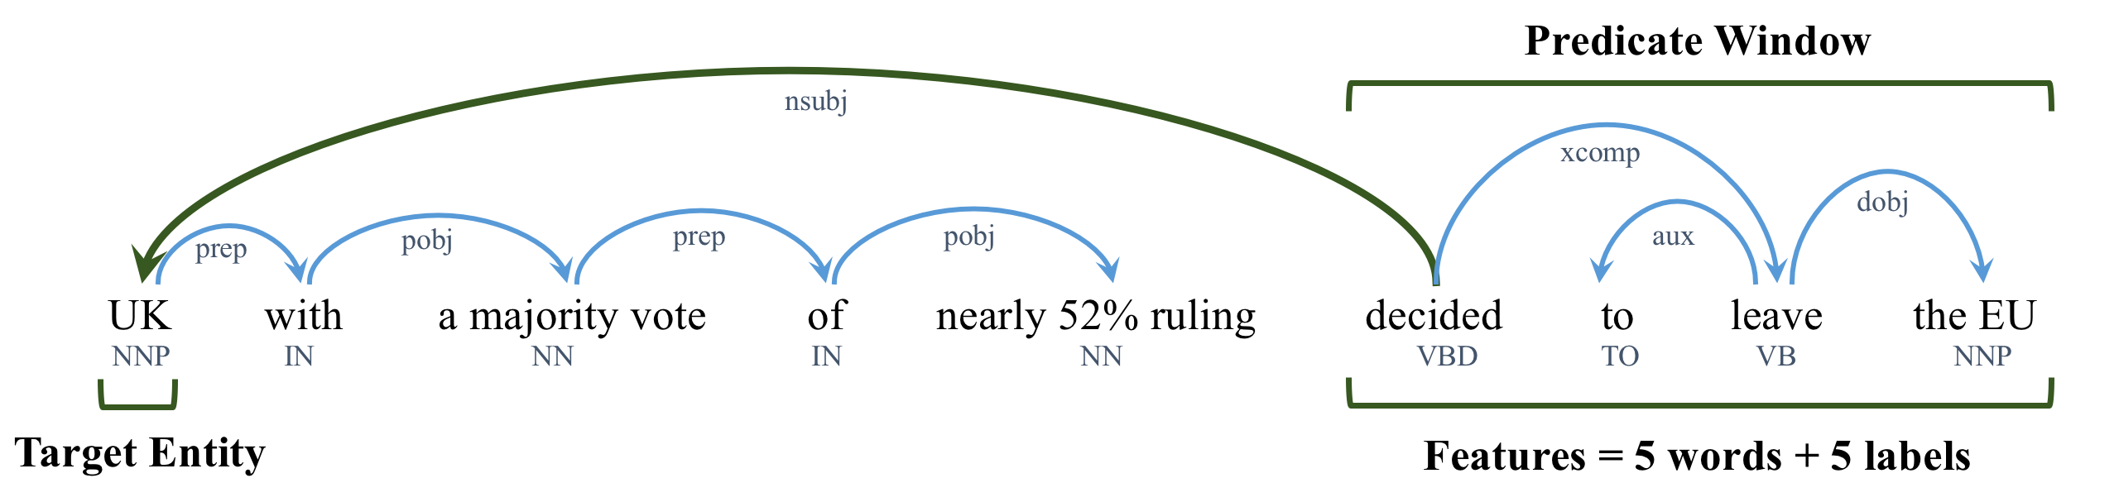
what is PREWIN?
BASELINE 5, 10, 50 windOW
Collobert et al. (2011), Mikolov et al. (2014)

Slide 9
THE ROAD MAP
the problem + brief HISTORY
PREWIN
FEATURE SELECTION
MODEL
MINIMALIST NN
RELOCAR
NEW DATASET
RESULTS + SUMMARY

Slide 10
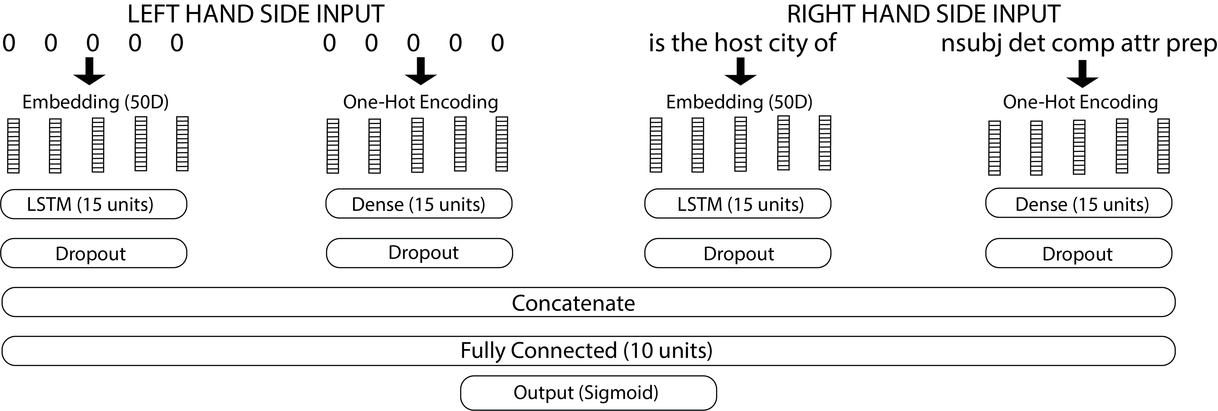
keras minimalist model

Slide 11
THE ROAD MAP
the problem + brief HISTORY
PREWIN
FEATURE SELECTION
MODEL
MINIMALIST NN
RELOCAR
NEW DATASET
RESULTS + SUMMARY

Slide 12


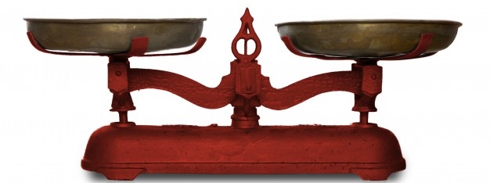
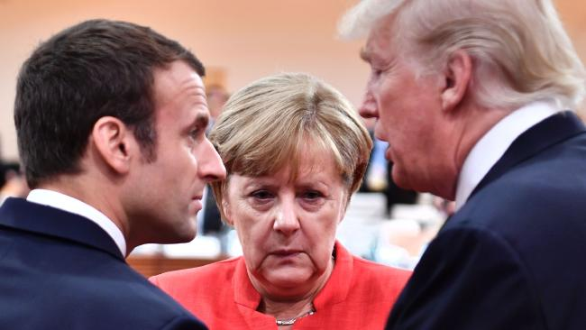

ReLOCAR (REAL LOCATION RETRIEVAL) VERSUS SEMEVAL
Germany, US and France talk climate science,
TRAIN 1,026
MIXED 2%
LITERAL 49%
METONYMIC 49%
TEST 1,000
ANNOTATED AT CAMBRIDGE UNI FACULTY
FOR MODERN AND MEDIEVAL LANGUAGES

Slide 13
THE ROAD MAP
the problem + brief HISTORY
PREWIN
FEATURE SELECTION
MODEL
MINIMALIST NN
RELOCAR
NEW DATASET
RESULTS + SUMMARY

Slide 14
the results
ENSEMBLE 84.6%
ENSEMBLE 84.8%

Slide 15
the results

Slide 16
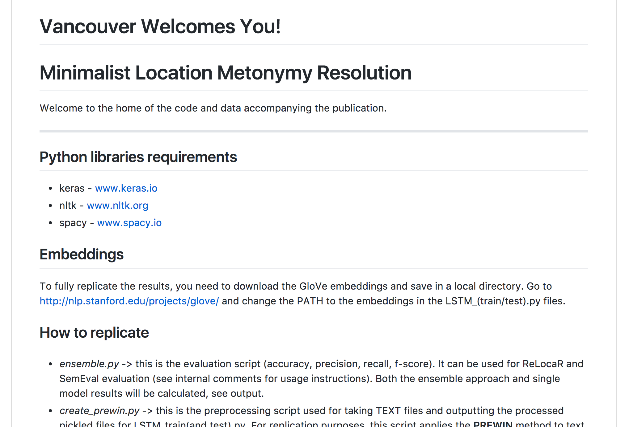
science replication
GitHub for
code & data &
instructions.
data.cam.ac.uk
repository.cam.ac.uk

Slide 17
summary & Future work
RELOCAR
More test DATA
PREWIN
FEATURE SELECTION
MODEL
MINIMALIST NN
NEr does not do metonymy
Metonymy AS orgs, locs, products…
small data & model CAN work

Slide 18

Thank YOU all
especially
www.dream-cdt.ac.uk

